Slide 1
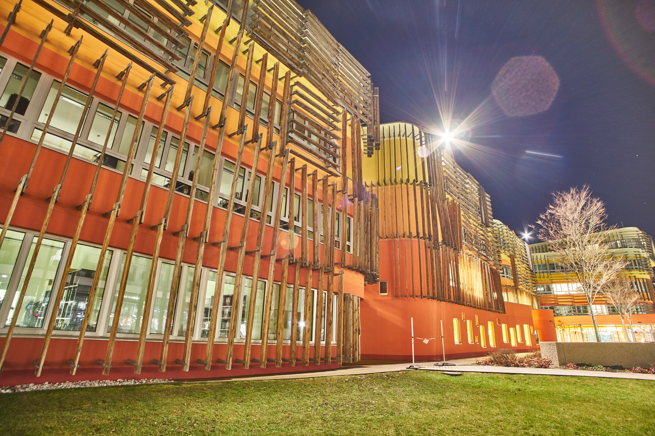
Organization matters
Principles of Software Programming
Anton Yeshchenko
SS 2018
March 2018

Slide 2

About me
Anton Yeshchenko, MSc.
PhD student / Researcher at WU
Researcher at department of Information Systems and Operations Institute for Information Business
Building D2, 3rd Floor. Email: anton.yeshchenko at wu.ac.at
Interests:
Process mining
Predictive monitoring
NLP
Machine learning
Hobbies:
Filmmaking
Triathlon
Travelling journalism

Slide 3
About you?
Name
One hobby
Programming experience
Why here (in programming class)?

Slide 4
Technical goal - Exam
Running semester dates:
12.05.2018 - 12:00 - 13:30
28.06.2018 - 14:00 - 15:30

Slide 5
Knowledge goals
Understand:
How computer actually works?
How “program” actually works in computer?
How to think in terms of programmable solutions about practical problems?

Slide 6
Knowledge goals
Understand:
How computer actually works?
How “program” actually works in computer?
How to think in terms of programmable solutions about practical problems?
Be able to:
Implement (design and code) solutions for problems
Read programs written by others
Make critical judgements on the quality of different implementations

Slide 7
Content of the course
From hardware to code (software)
Variables, data types
Control flow: branching, iteration, functions
Basic data structures, algorithms
Object oriented programming:
Classes, objects
Inheritance, method overriding
Information hiding
Recursion
Extra (Wahlfach):
Exceptions,
Dynamic data structures,
algorithms

Slide 8
Learning ways
8 + 1 lectures
(non bothering)
1. Quizzes
Notes:
Quizzes to assess the understandability of the material

Slide 9
Learning ways
8 + 1 lectures
(non bothering)
1. Quizzes
(hopefully interesting)
2. Theory
Notes:
Quizzes to assess the understandability of the material

Slide 10
Learning ways
8 + 1 lectures
(non bothering)
1. Quizzes
(hopefully interesting)
2. Theory
(collaborative and engaging)
3. In class exercises
Notes:
Quizzes to assess the understandability of the material

Slide 11
Learning ways
8 + 1 lectures
(non bothering)
1. Quizzes
(hopefully interesting)
2. Theory
(collaborative and engaging)
3. In class exercises
(not ignored?, proactive)
4. Home (practical) exercises
Notes:
Quizzes to assess the understandability of the material

Slide 12
Resources for the course
Course page with
exam topics
lecture slides (uploaded after the lecture)
exercises
https://learn.wu.ac.at/dotlrn/classes/pool/6088.18s
Alternativelly:
https://github.com/yesanton/Principles-of-Programming-6088-S18-Course-materials
Python notebook created for you
https://programming.ai.wu.ac.at/6088/notebooks/$STUDENTID

Slide 13
Resources on internet (to learn python)
https://ocw.mit.edu/courses/electrical-engineering-and-computer-science/6-0001-introduction-to-computer-science-and-programming-in-python-fall-2016/
https://www.coursera.org/learn/learn-to-program
https://imgur.com/gallery/3wSHJ
http://www.python-course.eu/python3_course.php
http://docs.python-guide.org/en/latest/
http://diveintopython.net
https://pythontips.com/2016/02/27/learning-python-for-data-science/
https://talkpython.fm
https://github.com/jupyter/jupyter/wiki/A-gallery-of-interesting-Jupyter-Notebooks
https://learnpython.wordpress.com
http://www.pythontutor.com
https://www.codecademy.com/learn/python
http://interactivepython.org/courselib/static/thinkcspy/index.html
https://github.com/gregmalcolm/python_koans

